Slide 1
CSS342 Data Structures, Algorithms, and Discrete Mathematics (I)

Slide 2
Notices
Disco: https://discord.gg/Q2n7tb
Class info/discussion
Homework discussion
Canvas:
Homework submission
Class announcement
Email:
Almost never

Slide 3
Homework Rules
Work alone unless specified otherwise
No Plagiarism
“the practice of taking someone else's work or ideas and passing them off as one's own”
Use internet resources for idea is OK if proper credit is given
“I got this algorithm idea from xxx”
Serious consequence!!!
Late homework will NOT be accepted
exception will be given on a very very rare and case by case basis with legit proof of circumstances
Ask questions on disco/slack channels and/or at office hours

Slide 4
Homework Review
link to home 1
DUE: 10/4/2019 Friday 11:59pm
Revert()
How are you implementing it?
How much additional space are you using?

Slide 5
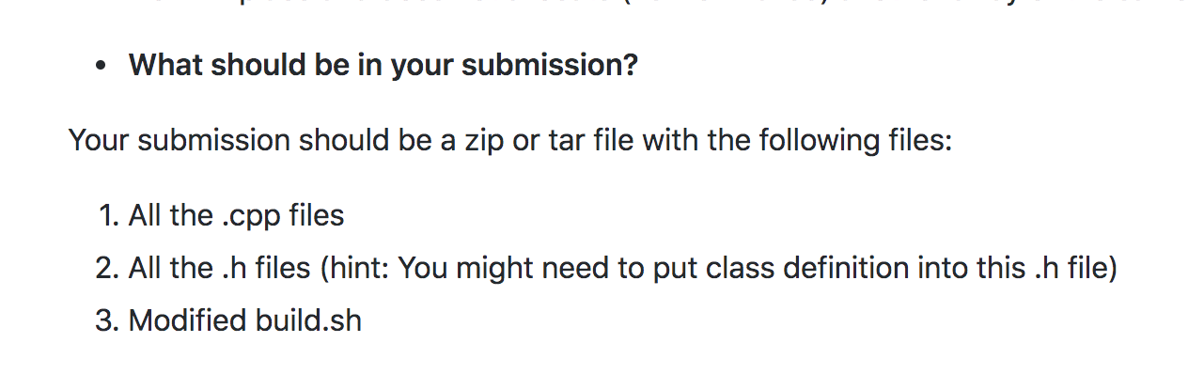
Homework Review
Windows (Visual Studio) users: Make sure you code compiles on Linux Ubuntu 18.04

Slide 6
Homework Review
Where do I get a Linux?
EC2 Instance (aka “a machine in the Amazon cloud”)
Free tier
Detailed video tutorial
Similar offering (Azure, Google Cloud)
AWS EC2
x.x.x.x
VM
Free machine you can use (when you need it),
and then destroy and forget

Slide 7
EC2 Demo
Get an Linux 18.04 machine from AWS EC2
Copy codes from Windows to this machine for homework submission validation (next class)

Slide 8
Goal by the end of this week (10/8, 10/10)
Setup your C++ development environment
Join Disco
Make sure your first homework is submitted on time and meeting requirements
Get comfortable with write C++
Don’t need to know everything. Basics first.
Quiz on C++ materials we cover this week on 10/8 Tuesday

Slide 9
C++
We will only review C++ quickly
If in high doubt
CSS332 Programming with object oriented languages
A longer “boot camp” on C++
Although this is not a prerequisite for CSS342, do take this class if at all possible if you are not familiar with C++
Quantitative Skills Center (tutoring) – Visit http://www.uwb.edu/gsc for more information
A good video tutorial series

Slide 10
C++ Review
Memory (memory_examples)
Heap
“new/delete” operator
malloc/free
Stack
Statically defined variable
https://www.geeksforgeeks.org/memory-layout-of-c-program/

Slide 11
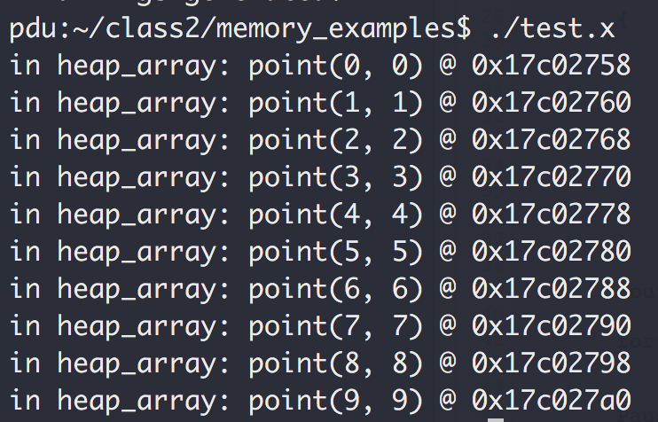
C++ Review
“hexadecimal”
0x17c02758
1 byte
Sizeof(int)
4 bytes
Sizeof(point)
8 bytes
0x17c02760
0x17c02760
0x17c02758 + 0x8 = 0x17c02760

Slide 12
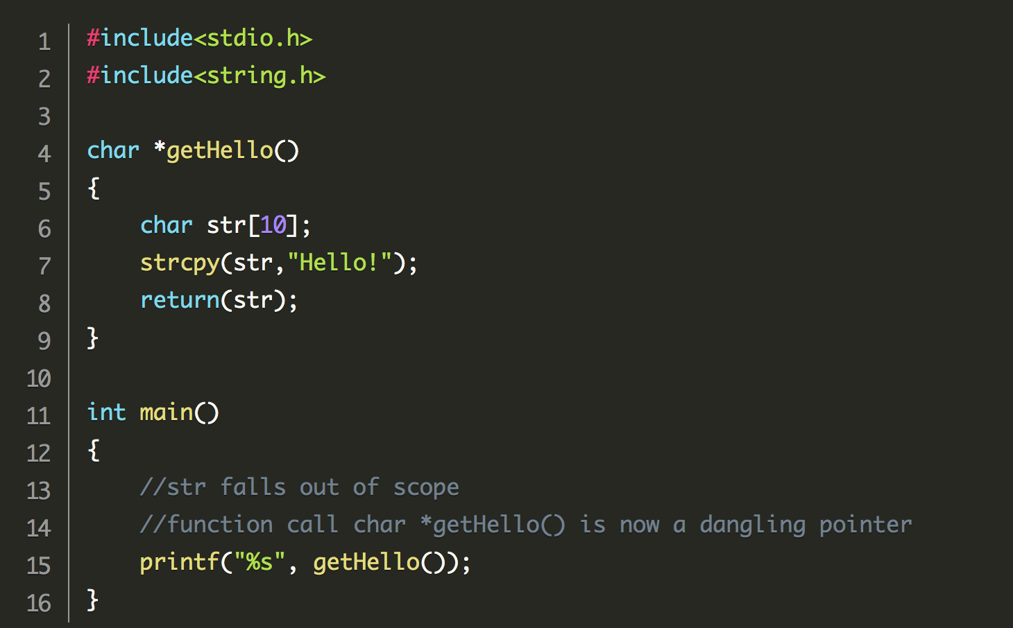
C++ Review
Memory leaks
Allocated (“new”) but not deleted
Use Valgrind to check
Dangling pointer
https://developerinsider.co/what-is-dangling-pointer-with-cause-and-how-to-avoid-it/

Slide 13
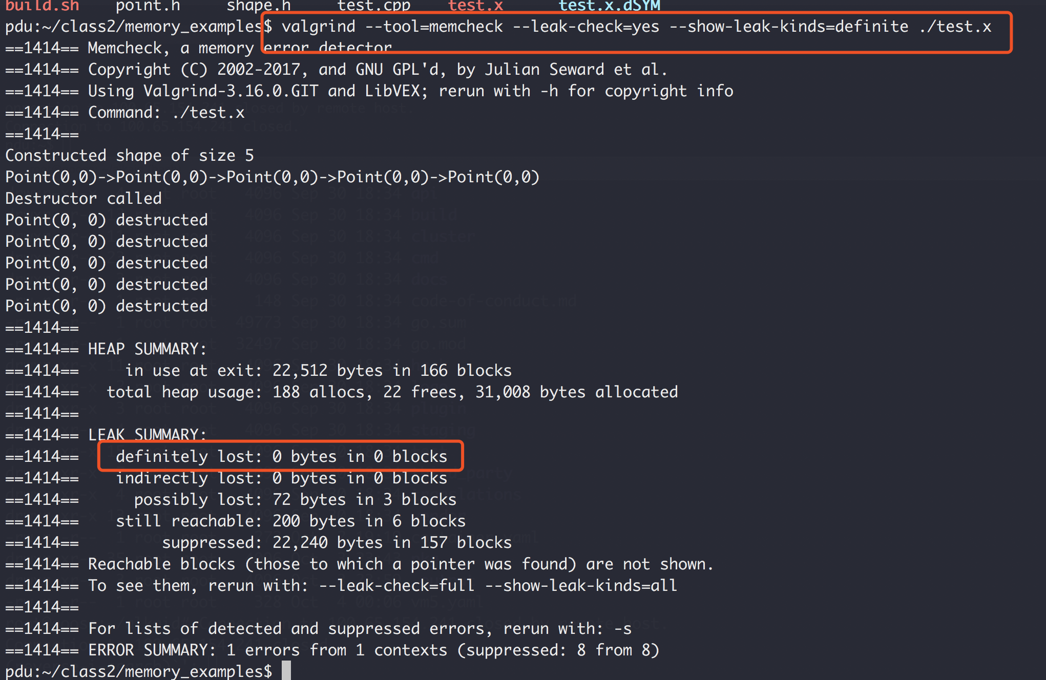
C++ Review
Check for memory leak: valgrind

Slide 14
C++ Review
Struct vs Class (struct_vs_class)
What’s the difference between Struct and Class in C++?

Slide 15
C++ Review
Function parameter Passing (pass_by_ptr_val_ref)
By value
By pointer
By reference

Slide 16
C++ Review
Polymorphism: function overload (function_overload)

Slide 17
C++ Review
Polymorphism, Virtual function (virtual_function_example)

Slide 18
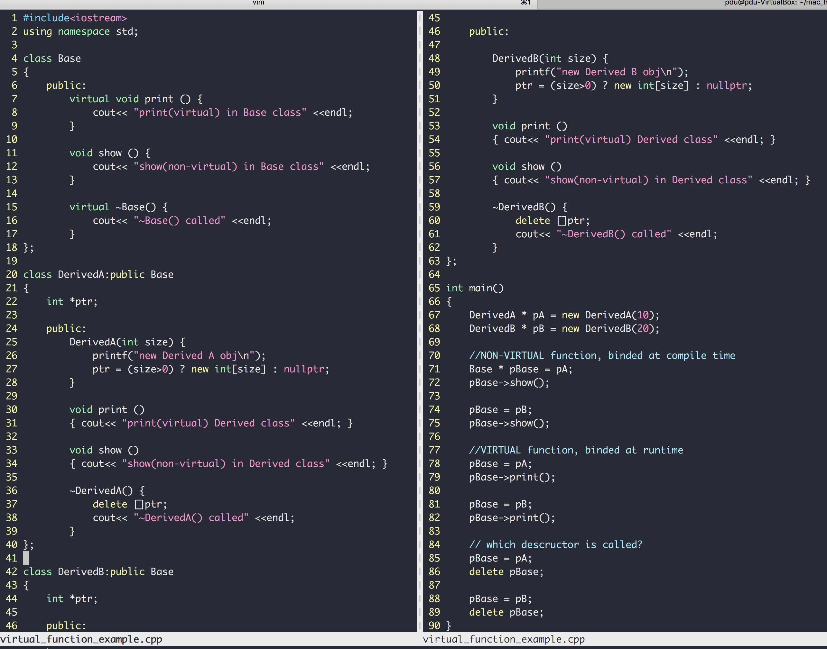
C++
“DerivedA class is a kind of Base class"
Class inheritance
Polymorphism
Virtual members
Pointers to base class
Invoke derived func
more example here
Same base pointer, different functions invoked (dynamic binding)

Slide 19
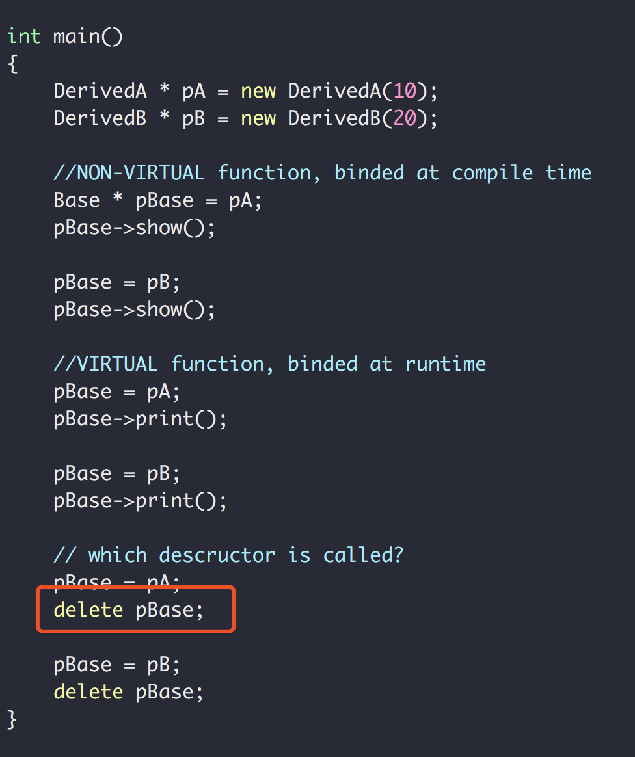
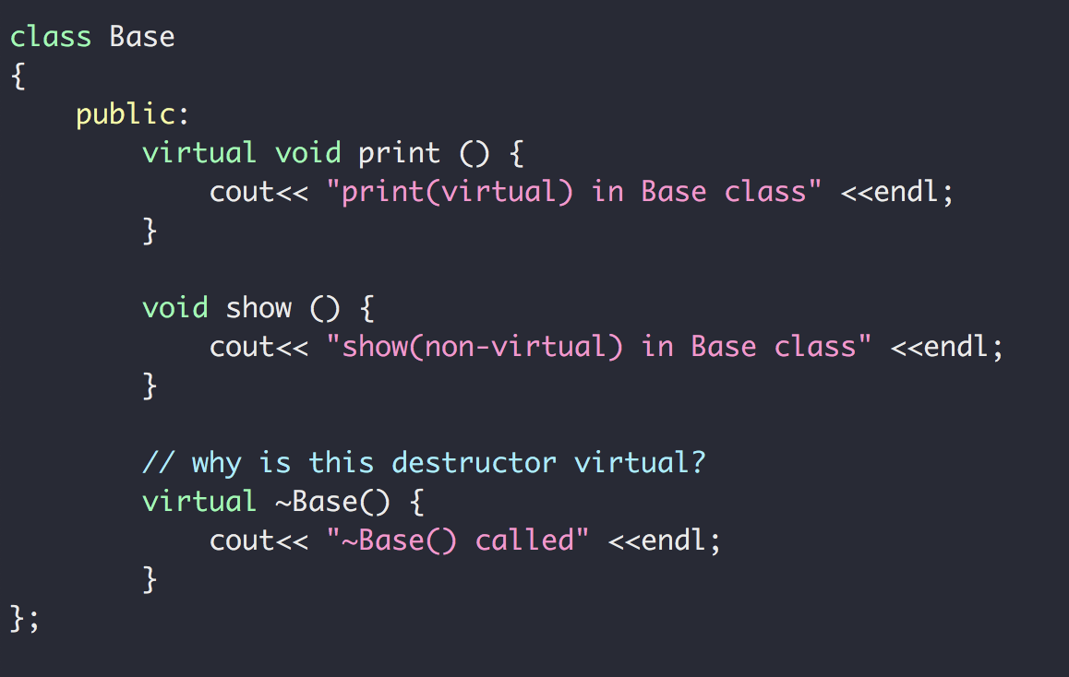
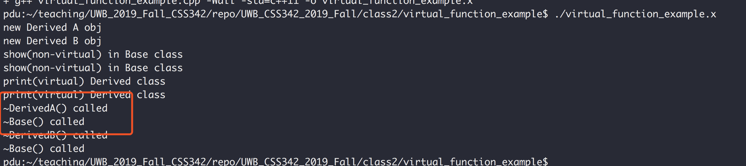
C++
So why the virtual destructor?
Also see https://www.youtube.com/watch?v=jELbKhGkEi0&t=56s

Slide 20
C++
More on virtual class
Virtual Table

Slide 21
C++ Exercise
A card class
Has only one member function called area() that returns the area of the card
Write the class for card, square card and circular card
area() is implemented in the way of polymorphism
Square Card
Area = width x height
card
Circular Card
Area = pi x radius²
Area = ??

Slide 22
C++ Review
Template
A parameterized blueprint
Function Template (code: function_template)
Class Template (code: card_exercise/templated_version/)

Slide 23
Compiler & Linker
g++ -Wall -c circular_card.cpp -o circular_card.o
Compiler
Source Code
Object file
g++ -Wall -c rectangular_card.cpp -o rectangular_card.o
g++ -Wall -c test.cpp -o test.o
g++ rectangular_card.o circular_card.o test.o -o test.x
Executable binary
(“.exe” for Windows)
g++ -Wall circular_card.cpp rectangular_card.cpp test.cpp -o test.x

Slide 24
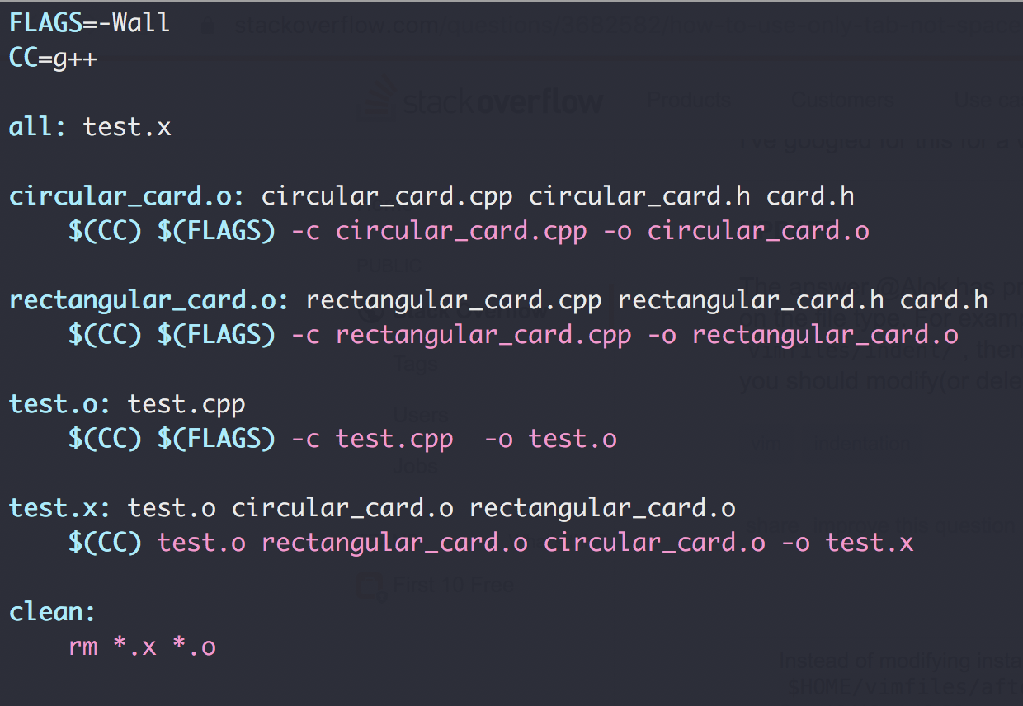
Makefile
goal
dependencies
actions

Slide 25
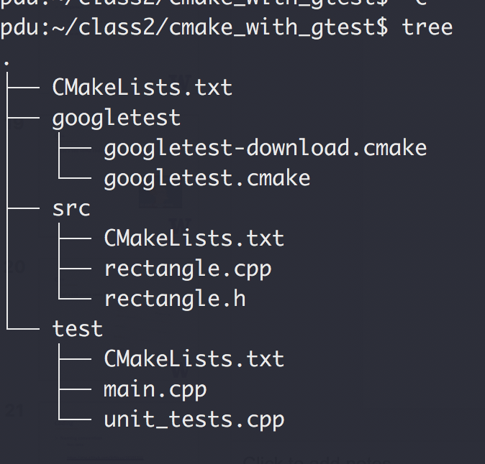
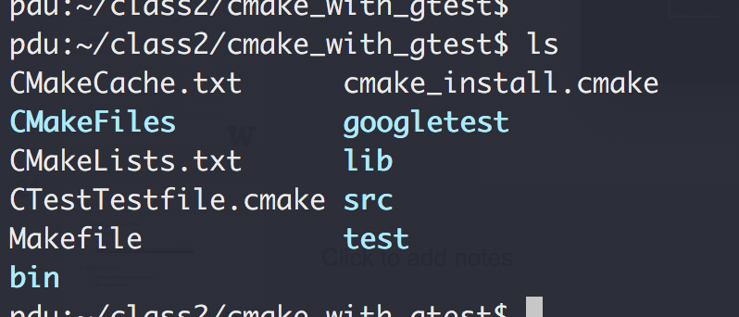
CMake
Tools that write Makefile for you!
Cross-platform (Yes, Windows too)
cmake .
make

Slide 26
Unit Test Framework
Googletest
Unit test framework from Google
File structure

Slide 27
C++
Let’s see some code (cmake_with_gtest)

Slide 28
Coding
Naming convention
Not strict
https://gist.github.com/lefticus/10191322
Bottomline:
Pick and follow a rule set
Be consistent

Slide 29
Coding
Avoid duplicates
No same logic more than once!
Comments
On intent, not action
Modular
Cohesion: 1 task per module
Coupling: As loosely coupled as possible
Variable Naming
Jacob’s guide

Slide 30
Coding
Testing
Unit tests
Integration tests
Test Driven Development
Video: “TDD, Where Did It All Go Wrong”

Slide 31
END OF C++ REVIEW

Slide 32
Exercise

Slide 33
Object-Oriented Analysis And Design
What does “problem solving” mean?
Give a list of elements, implement the following function:
Add an element to the back of the list push_back(…)
Remove an element from the front of the list pop_front(…)
3
9
1
7
5
4
2
0
pushBack(…)
popFront(…)
4
2
0

Slide 34
Object-Oriented Analysis And Design
What does “problem solving” mean?
Give a list of elements, implement the following function:
Add an element to the back of the list push_back(…)
Remove an element from the front of the list pop_front(…)
10 mins, design and write the code
Use array in C++ to storage the data

Slide 35
Object-Oriented Analysis And Design
Let’s see some code

Slide 36
Object-Oriented Analysis And Design
What does “problem solving” mean?
Give a list of elements, implement the following function:
Add an element to the back of the list push_back(…)
Remove an element from the front of the list pop_front(…)
Procedural (aka steps)
Class Entity
array
Array
pushback()
popFront()
Member variables
PushBack()
Member functions
PopFront()
Test
Test()

Slide 37
Design Principals (“Specification” in C++ ch. 1.3)
Modular design
Split a problem into modules (e.g. classes)
Each modules states what it does
No module “know” how any other module works
Applies to
Single application (e.g. main, list, test)
Large scale Microservices (see how Uber does it)
And remember the class scheduling example?

Slide 38
Design Principals (“Specification” in C++ ch. 1.3)
https://medium.com/edureka/microservice-architecture-5e7f056b90f1

Slide 39
Design Principals (“Specification” in C++ ch. 1.3)
Operation Contracts
What methods are available to public
How a method can be used
Inputs
Outputs
Exception
What limitations
Example:
List in C++ Standard Template Library (STL)
Facebook’s /{object-id}/likes API

Slide 40
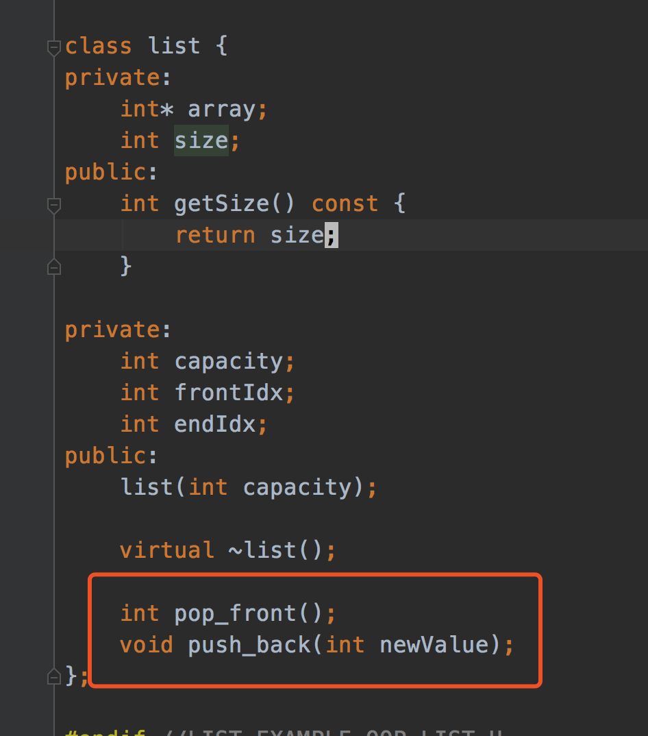
Design Principals (“Specification” in C++ ch. 1.3)
Unusual Conditions
Assume invalid situations never occur
Ignore the invalid situations
Guess (Assume) client’s intention
Return a value signaling a problem
Throw an exception
Error Hiding (swallowing)

Slide 41
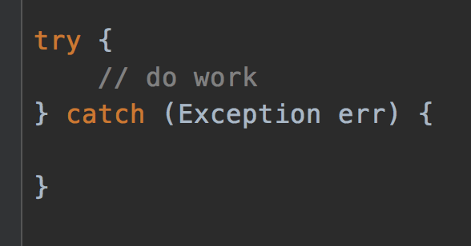
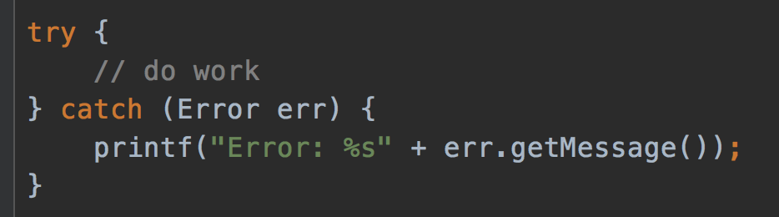
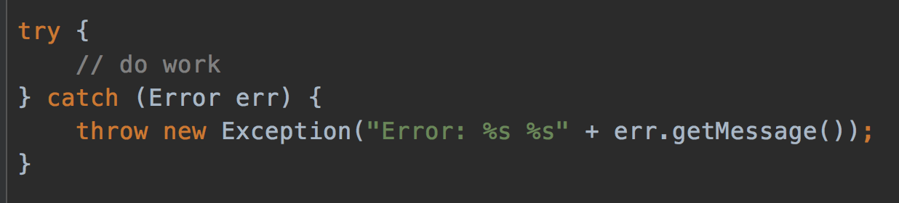
Error hiding
VERY BAD
STILL BAD
GOOD, but how to improve?
https://www.ibm.com/support/pages/best-practice-catching-and-re-throwing-java-exceptions

Slide 42
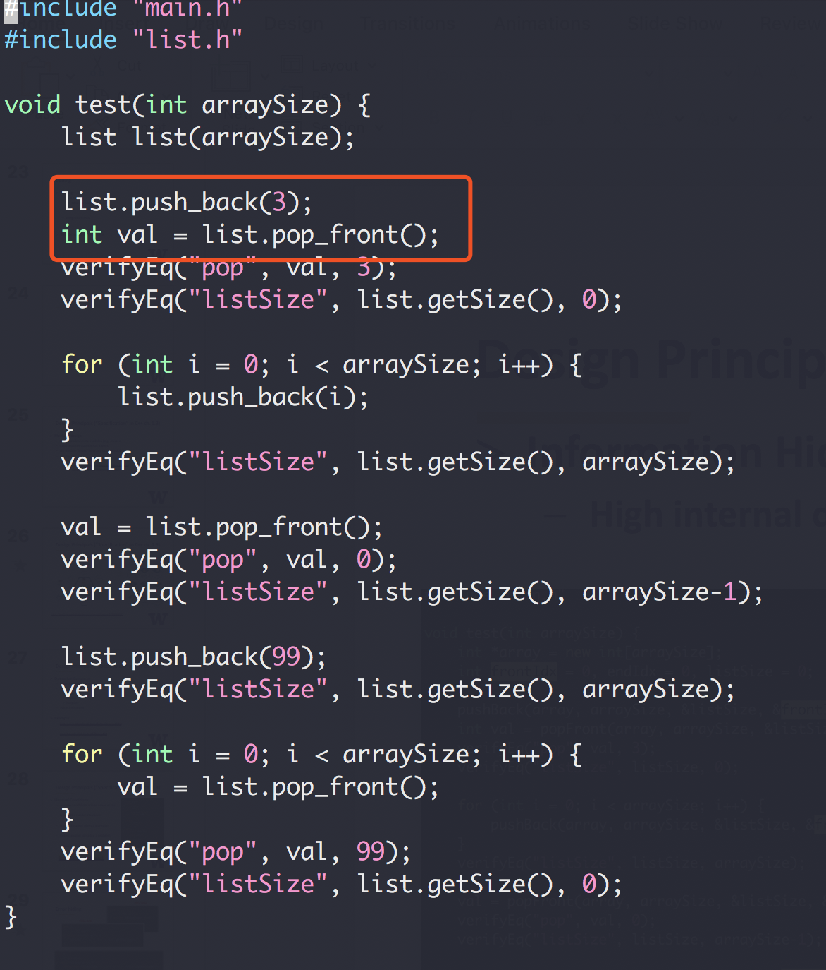
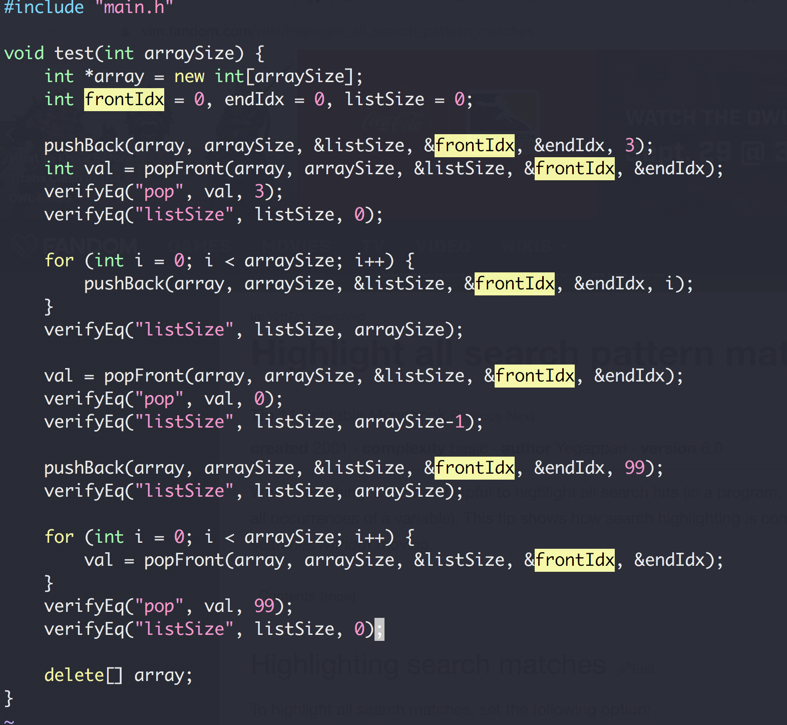
Design Principals (“Specification” in C++ ch. 1.3)
Information Hiding
High internal details from external clients

Slide 43
OOP Design
A bag of card of different shape cards
Exercise

